Slide 1
WORLD OF LASERS
Laser Application: Data Storage

Slide 2
DATA STORAGE
Laser has a high spatial coherence and can thus be used to address very tiny spots in the recording medium, allowing a very high density data storage.

Slide 3
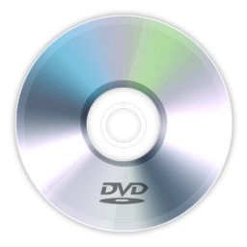
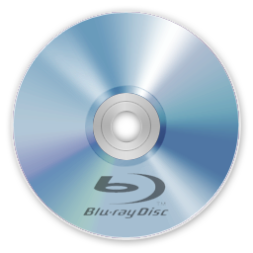
DATA STORAGE
Laser is applied to optical data storage e.g. in compact disks (CDs), DVDs, Blu-ray Discs and magneto-optical disks

Slide 4
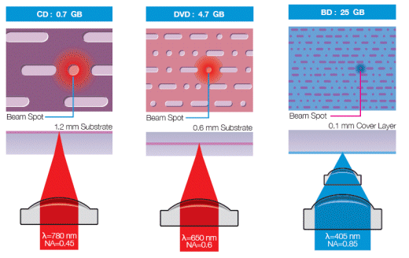
DATA STORAGE
CD vs DVD vs Blu-ray Disk

Slide 5
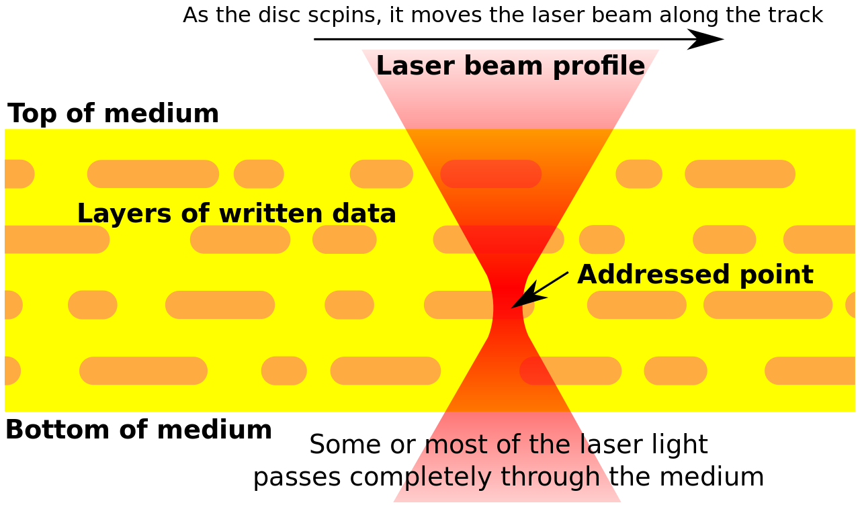
DATA STORAGE

Slide 6
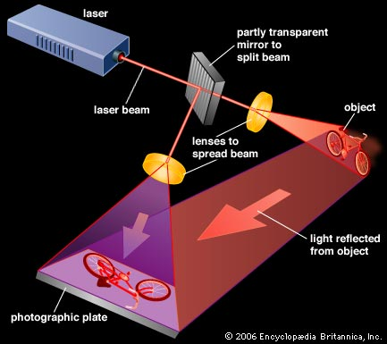
DATA STORAGE
Another case is holography, where the temporal coherence can also be important.

Slide 7
?
WELL DONE!
Move on to the next laser application...
COMMUNICATION!

